Slide 1
Welcome to
CHMG-141, General & Analytical Chemistry I
Dr. Alla Bailey

Slide 2
CHMG-141-02 General & Analytical Chemistry I (Fall Semester)
Throughout the course you will gain some important skills. These include:
    Dimensional analysis & unit conversion
    Basics of chemical bonding and nomenclature
    Balancing chemical equations
    Solving limiting reagent problems
    Chemical logic – Qualitative Analysis
    Use of the Periodic Table to predict Electron Configuration and Periodic Properties
    Working with moles, molar mass, and molarity
    Predicting molecular shape and polarity
    Energy and entropy changes that drive chemical reactions
    Gases, Liquids, and Solids

Slide 3

TEXTBOOK
(The same for two semesters: CHMG-141 and 142)
Steven S. Zumdahl; Susan A. ZumdahlChemistry: An Atoms First Approach, 2nd Edition (Recommended). E-book (comes with OWL Homework) or Printed (if you want it)
Please read the "The Textbook Options" posted in MyCourses.
Other Recommended resources:
Power Point Lectures: posted in the content folder of MyCourses; the lectures are based on the text book recommended.
Few Recorded Lectures (Video): posted in MyCourses, content folder
Thinkwell Video in OWL e-book

Slide 4
Class Meetings:
Lectures: Tuesday and Thursday: 8:00-9:25AM, Thomas Gosnell Hall (GOS)-1250
Recitation sessions: one per week, 1 hour each (Fridays).The class is divided into four sections: see the schedule in the Syllabus

Slide 5
Class Meetings:
Recitations (Fridays, 4 sections):
CHMG 141-02R1 | Gen & Analytical Chemistry I (Recitation) |  | Fr 2:00PM - 2:50PM | James E Gleason Hall(GLE)-2159
CHMG 141-02R2 | Gen & Analytical Chemistry I (Recitation) |  | Fr 9:00AM - 9:50AM | Golisano Hall (GOL)-1610
CHMG 141-02R3 | Gen & Analytical Chemistry I (Recitation) |  | Fr 10:00AM - 10:50AM | Institute Hall (INS)-1180
CHMG 141-02R4 | Gen & Analytical Chemistry I (Recitation) |  | Fr 1:00 PM - 1:50PM | Thomas Gosnell Thomas Gosnell Hall (GOS)-3305

Slide 6
MyCourses gives you access to everything
  News
  Content
  Discussion board
  Gradebook updated fully after each exam

Slide 7
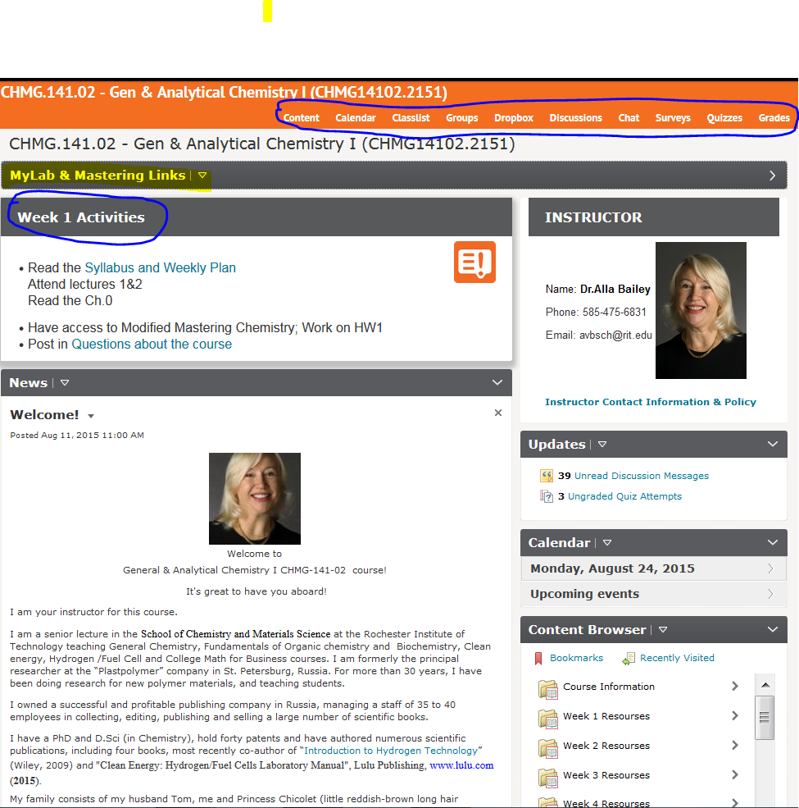

Slide 8
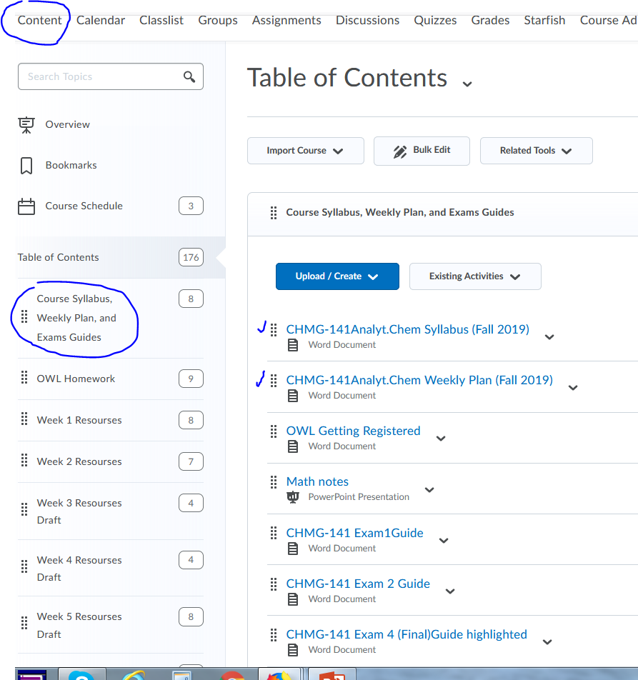
MyCourses “Content Folder”

Slide 9
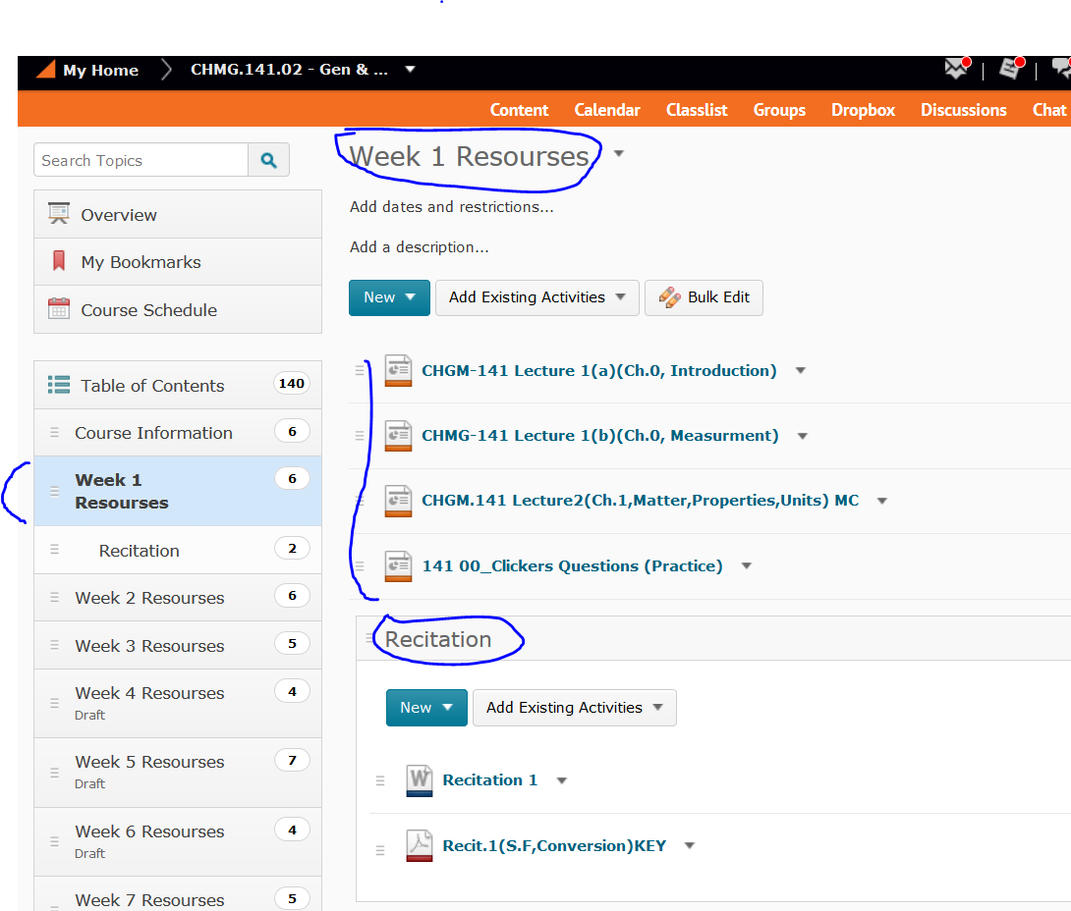
MyCourses
“Content Folder”

Slide 10
Recitations
New material
Exercise sets given out each week
Fun
Get closer to your instructors
Worksheets will be collected and graded (gives you 7% of your final grade

Slide 11
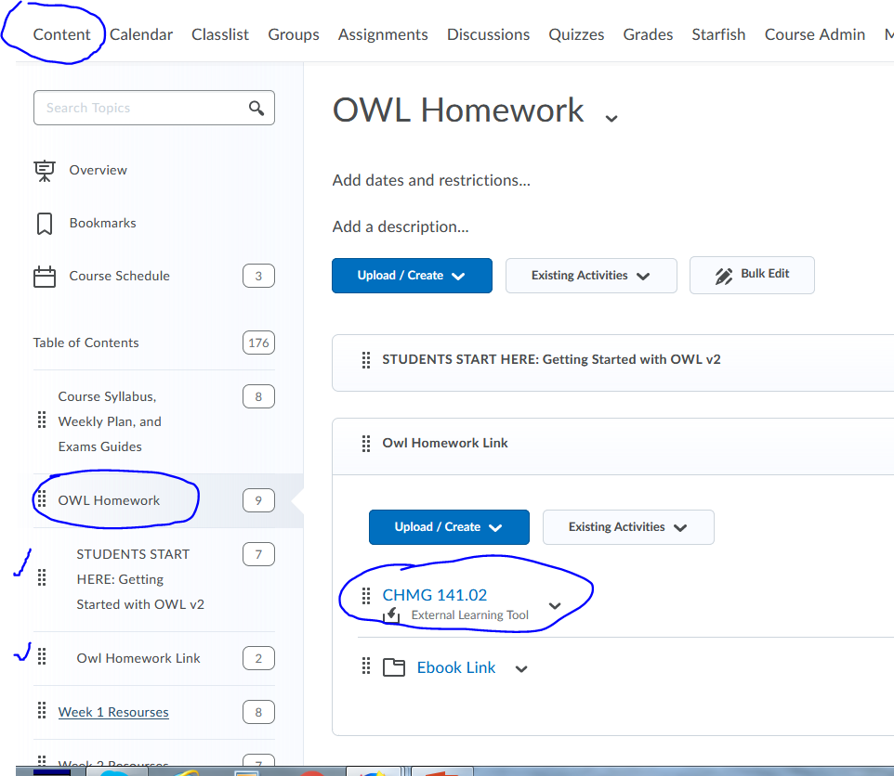
Weekly Homework (OWL)

Slide 12
Grading Policies
Three Exams (drop lowest): 44%
Final Exam: 22%
Homework: 17.75%
Quizzes, 6%
Recitations: 7%
Attendance: 3.75%
Introduce yourself 0.25%
________________________________
Total 100%
Clicker Questions (max 2 Bonus Points)

Slide 13
Exams
4 exams: in our class room (GOS)-1250
Three exams will be given throughout the semester. THE LOWEST EXAM GRADE IS DROPPED.
A FINAL EXAM (compulsory) will be giving during Finals’ Week. The Final Exam is mandatory and cannot be dropped.

Slide 14
Exam dates will be announced later.
Tentative schedule:
Exam 1 - week 6
Exam 2 – week 12
Exam 3 - week 15
Exam 4 (Final) – 12/17/2019, Tue, 8:00AM - 10:30AM, (GOS)-1250

Slide 15
Quizzes
Quizzes will be conducted online through MyCourses.
There are will be five quizzes.
Quizzes schedule:
Quiz 1 - Thu, Sep 12
Quiz 2 – Thu, Sep 26
Quiz 3 - Thu, Oct 24
Quiz 4 - Thu, Oct 31
Quiz 5 - Tue, Nov 26
Quiz 6 – Mon, Dec 9

Slide 16
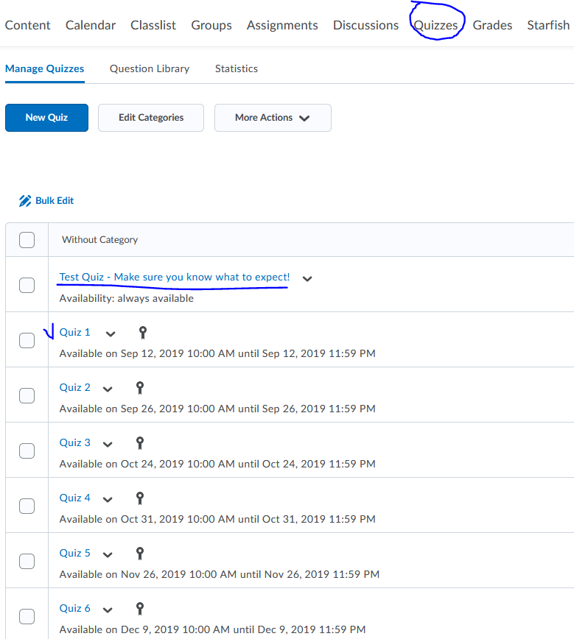
MyCourses Quizzes

Slide 17
Clickers
Fun learning tool
Many questions, some of which carry bonus credit (2 point to your final grade.)
Allow you to tell/teach me!!
Allow you to set the pace of the class
Can sell them back to bookstore or use in CHMG.142 second semester course

Slide 18
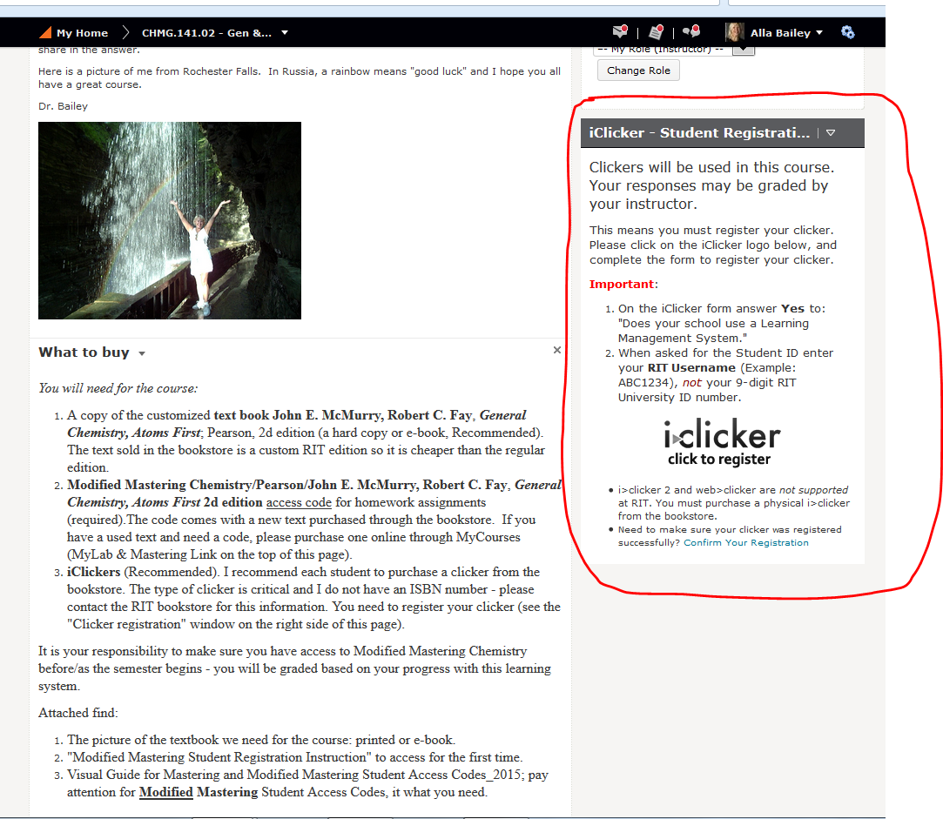

Slide 19
THE GRADING SCALE:
PERCENTAGE | GRADE
92 | A
90 | A-
88 | B+
82 | B
80 | B-
78 | C+
72 | C
70 | C-
68 | D+
62 | D
60 | D-
59 and lower | F

Slide 20
Office Hours:
Monday: 10:00-11:00 AM
Tuesday: 9:30 – 11:00 AM
Thursday: 9:30 – 11:00 AM and
1:30 – 2:30 PM or by appointment
My office is COS (08) - 3260

Slide 21
Other stuff
Semesters go quickly
Material starts easy, gets difficult quickly
Let’s come back to
OWL Homework Registration
Textbook

